Slide 1
Assembler Features
Machine Dependent Assembler Features
  Instruction formats and addressing modes (SIC/XE)
  Program relocation
Machine Independent Assembler Features
  Literals
  Symbol-defining statements
  Expressions
  Program blocks
  Control sections and program linking

Slide 2
Instruction Formats and Addressing Modes
Instruction formats depends on memory organization and the size of memory.
In SIC:
  only one instruction format.
  only two registers : register A and Indexed register
  support three addressing modes: Direct, Indirect and Indexed.
In SIC/XE:
  four different types of instruction

Slide 3
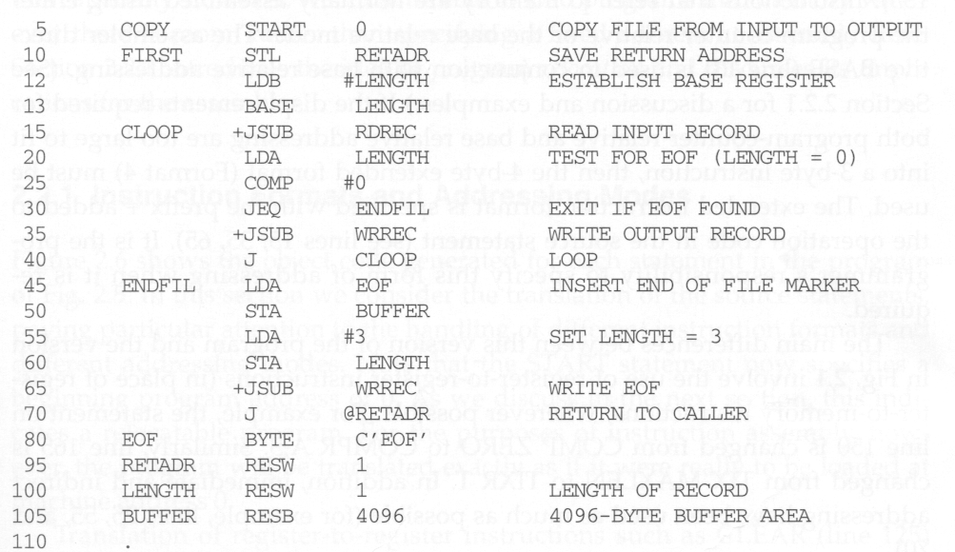
A SIC/XE Program

Slide 4
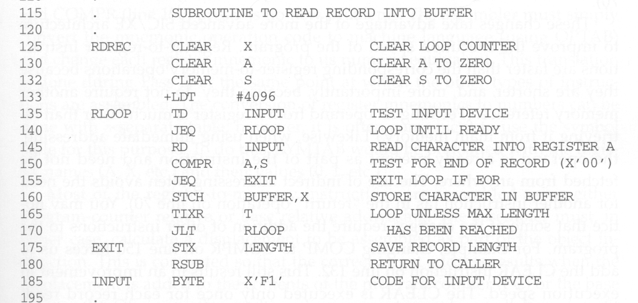

Slide 5
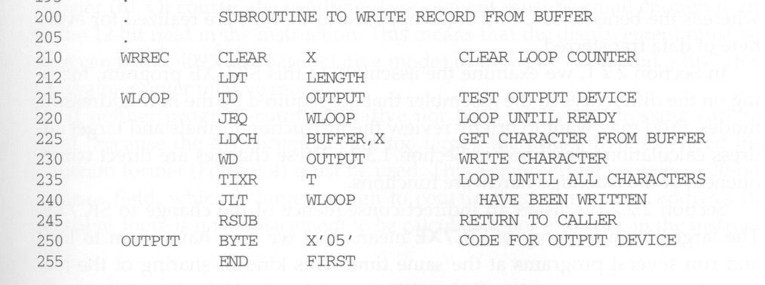

Slide 6
SIC/XE Instruction Formats and Addressing Modes
PC-relative or Base-relative (BASE directive needs to be used) addressing: op m
Indirect addressing: op @m
Immediate addressing: op #c
Extended format (4 bytes): +op m
Index addressing: op m,X
Register-to-register instructions COMPR

Slide 7
Relative Addressing Modes
PC-relative or base-relative addressing mode is preferred over direct addressing mode.
  Can save one byte from using format 3 rather than format 4.
    Reduce program storage space
    Reduce program instruction fetch time
  Relocation will be easier.

Slide 8
The Differences Between the SIC and SIC/XE Programs
Register-to-register instructions are used whenever possible to improve execution speed.
  Fetch a value stored in a register is much faster than fetch it from the memory.
Immediate addressing mode is used whenever possible.
  Operand is already included in the fetched instruction. There is no need to fetch the operand from the memory.
Indirect addressing mode is used whenever possible.
  Just one instruction rather than two is enough.

Slide 9
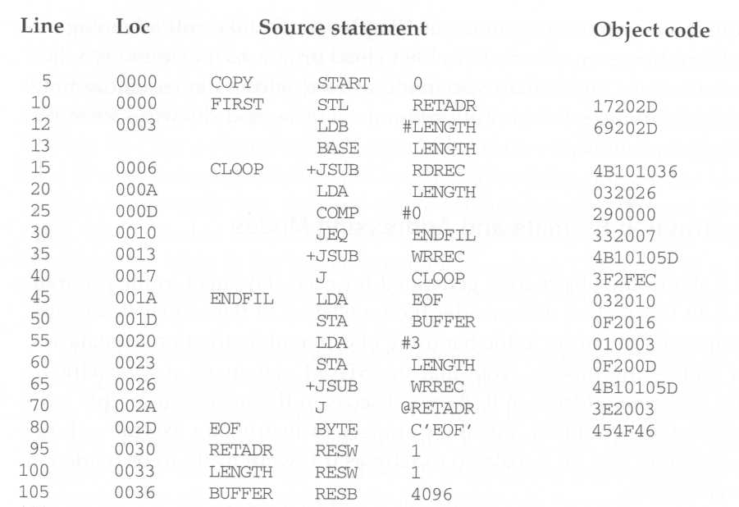
The Object Code for Fig. 2.5
Relocatable program

Slide 10
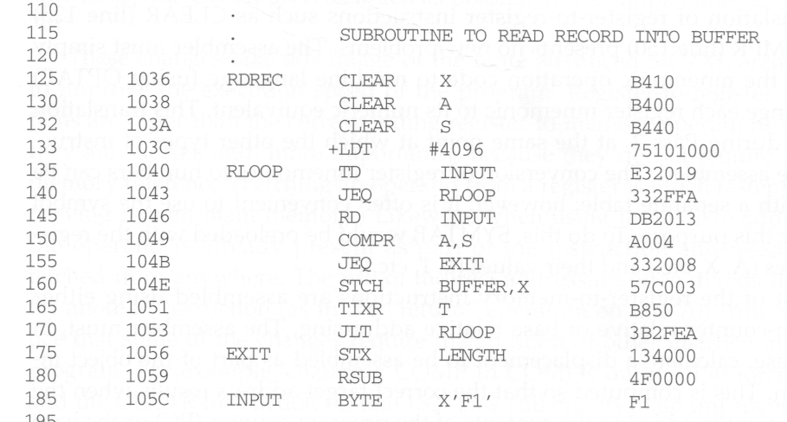

Slide 11
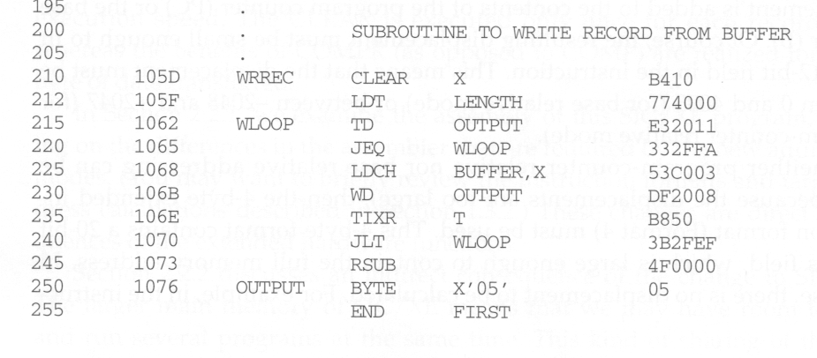

Slide 12
Generate Relocatable Programs
Let the assembled program starts at address 0 so that later it can be easily moved to any place in the physical memory.
  Actually, as we have learned from virtual memory, now every process (executed program) has a separate address space starting from 0.
Assembling register-to-register instructions presents no problems. (e.g., line 125 and 150)
  Register mnemonic names need to be converted to their corresponding register numbers.
  This can be easily done by looking up a name table.

Slide 13
PC or Base-Relative Modes
Format 3: 12-bit displacement field (in total 3 bytes)
  Base-relative: 0~4095
  PC-relative: -2048~2047
Format 4: 20-bit address field (in total 4 bytes)
The displacement needs to be calculated so that when the displacement is added to PC (which points to the following instruction after the current instruction is fetched) or the base register (B), the resulting value is the target address.
If the displacement cannot fit into 12 bits, then format 4 needs to be used. (E.g., line 15 and 125)
  Bit e needs to be set to indicate format 4.
  A programmer must specify the use of format 4 by putting a + before the instruction. Otherwise, it will be treated as an error.

Slide 14
PC-Relative Example (1)
  10 0000 FIRST STL RETADR 17202D
  12 0003
  (14)₁₆ 1 1 0 0 1 0 (02D) ₁₆
  (0001 0111) (0010 0000) (2D) ₁₆
    (17) ₁₆ (20) ₁₆ (2D) ₁₆
    displacement= RETADR - PC = 30 - 3 = 2D
op(6)
n
i
x
b
p
e
disp(12)
After fetching this instruction and before executing it,
the PC will be 0003.

Slide 15
PC-Relative Example (2)
    40 0017 J CLOOP 3F2FEC
    45 001A …….
    (3C)₁₆ 1 1 0 0 1 0 (FEC) ₁₆
  (0011 1111) (0010 1111) (FC) ₁₆
    (3F) ₁₆ (2F) ₁₆ (FC) ₁₆
    Displacement = CLOOP - PC= 6 - 1A= -14 = FEC
op(6)
n
i
x
b
p
e
disp(12)

Slide 16
Base-Relative v.s. PC-Relative
The difference between PC and base relative addressing modes is that the assembler knows the value of PC when it tries to use PC-relative mode to assembles an instruction. However, when trying to use base-relative mode to assemble an instruction, the assembler does not know the value of the base register.
  Therefore, the programmer must tell the assembler the value of register B.
  This is done through the use of the BASE directive. (line 13)
  Also, the programmer must load the appropriate value into register B by himself.
  Another BASE directive can appear later, this will tell the assembler to change its notion of the current value of B.
  NOBASE can also be used to tell the assembler that no more base-relative addressing mode should be used.

Slide 17
Base-Relative Example
The address of LENGTH,
not the content of LENGTH
(69202D)
12 LDB #LENGTH
13 BASE LENGTH
160 104E STCH BUFFER, X 57C003
( 54 )₁₆ 1 1 1 1 0 0 ( 003 ) ₁₆
(01010111) (1100)
(57) (C0) (03)
  Displacement = BUFFER - B = 0036 - 0033 = 3
op(6)
n
i
x
b
p
e
disp(12)

Slide 18
Immediate Addressing Example (1)
0003 LDB #LENGTH 69202D
( 68)₁₆ 0 1 0 0 1 0 (02D)₁₆
( 0110) (10 0 1) (0 0 1 0) (02D)₁₆
(69) (20) (2D)
The immediate operand is the value of the symbol LENGTH, which is its address (not its content)
Displacement = 0033 – 0006 = 002D
If immediate mode is specified, the target address becomes the operand.
op(6)
n
i
x
b
p
e
disp(12)

Slide 19
Immediate Addressing Example (2)
55 0020 LDA #3 010003
( 00 )₁₆ 0 1 0 0 0 0 ( 003 ) ₁₆
133 103C +LDT #4096 75101000
( 74 )₁₆ 0 1 0 0 0 1 ( 01000 ) ₁₆
op(6)
n
i
x
b
p
e
disp(12)
op(6)
n
i
x
b
p
e
disp(12)

Slide 20
Indirect Addressing Example
The target address is computed as usual (either PC-relative or BASE-relative)
We only need to set the n bit to 1 to indicate that the content stored at this location represents the address of the operand, not the operand itself.
70 002A J @RETADR 3E2003
( 3C )₁₆ 1 0 0 0 1 0 ( 003 ) ₁₆
  (0011) (1110) (0010) ( 003 ) ₁₆
  (3E) (20) (03)
  Displacement = 0030 – 002D = 0003
op(6)
n
i
x
b
p
e
disp(12)

Slide 21
Relocatable Is Desired
The program in Fig. 2.1 specifies that it must be loaded at address 1000 for correct execution. This restriction is too inflexible for the loader.
If the program is loaded at a different address, say 2000, its memory references will access wrong data! For example:
  55 101B LDA THREE 00102D
Thus, we want to make programs relocatable so that they can be loaded and execute correctly at any place in the memory.

Slide 22
Program Relocation
The need for program relocation:
  It is desirable to load and run several programs at same time.
  The system must be able to load programs into memory wherever there is room.
  The exact starting address of program is not known until load time.
Absolute Program:
  Program with starting address specified at assembly time.
  The address may be invalid if the program is loaded into somewhere else.

Slide 23
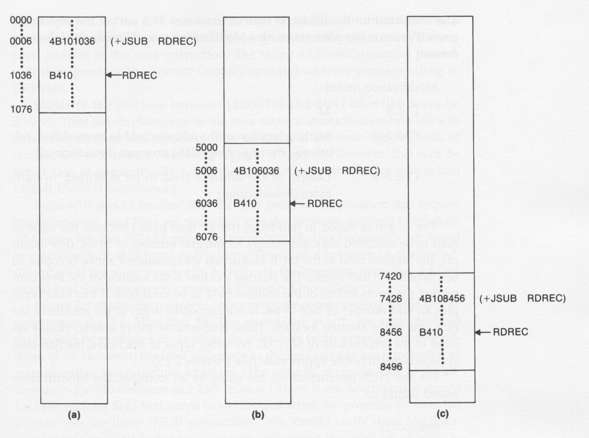
Address Modification Is Required

Slide 24
What Instructions Needs to be Modified?
Only those instructions that use absolute (direct) addresses to reference symbols.
The following need not be modified:
  Immediate addressing (no memory references)
  PC or Base-relative addressing (Relocatable is one advantage of relative addressing, among others.)
  Register-to-register instructions (no memory references)

Slide 25
Relocatable Program
The object program that contains modification record is called relocatable program.
To solve relocation program:
  address is assigned relative to the start of the program (START 0)
  produce a modification record to store starting location and length of address field to be modified.
  the command for loader i.e. instructing to add beginning address of program to address field, must be part of object program

Slide 26
The Modification Record
When the assembler generate an address for a symbol, the address to be inserted into the instruction is relative to the start of the program.
The assembler also produces a modification record, in which the address and length of the need-to-be-modified address field are stored.
The loader, when seeing the record, will then add the beginning address of the loaded program to the address field stored in the record.

Slide 27
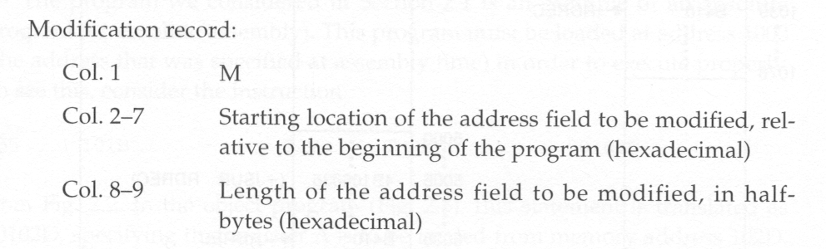
The Modification Record Format
Example: M00000705 for +JSUB RDREC
At half-byte boundary. The address field in the format 4
instructions has 20 bits – 5 half-bytes.
If the field contains an odd number of half-bytes, the starting
location begins in the middle of the first byte.

Slide 28
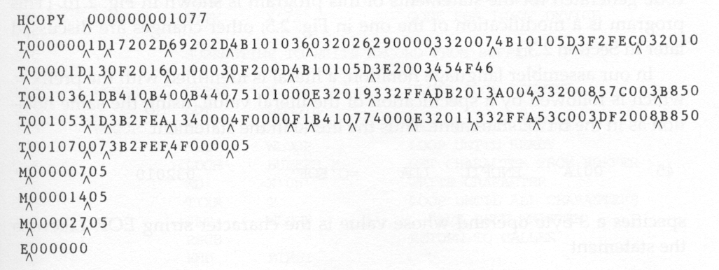
The Relocatable Object Code

